Slide 1

Decision Trees in Machine Learning
Hamid El Karim and Robert Mitchell

Slide 2
What is Machine Learning?
Machine Learning (ML)
Teaching computers to learn patterns from data.
Supervised Learning
Learning with labeled data, like classification and regression.
Unsupervised Learning
Learning with unlabeled data, like clustering and association.
Decision Trees
Belong to Supervised Learning type.

Slide 3
Learning styles in Machine learning algorithms
Unsupervised Learning
Supervised Learning
Raw data does not have a known result
Useful for pattern recognition and analysis
Predictive modeling that uses existing trained data to determine the accuracy of existing model and classify new data into existing the existing clusters
Examples:
K-means clustering algorithm: closest to K existing points in dataset
Ward’s Method: hierarchical cluster analysis minimizes variation within clusters (Used in K-means clustering algorithm)
Association rule mining: analyze relationships between two existing clusters
Supervised learning techniques:
Neural networks, Decision tree analysis, and statistical analysis

Slide 4
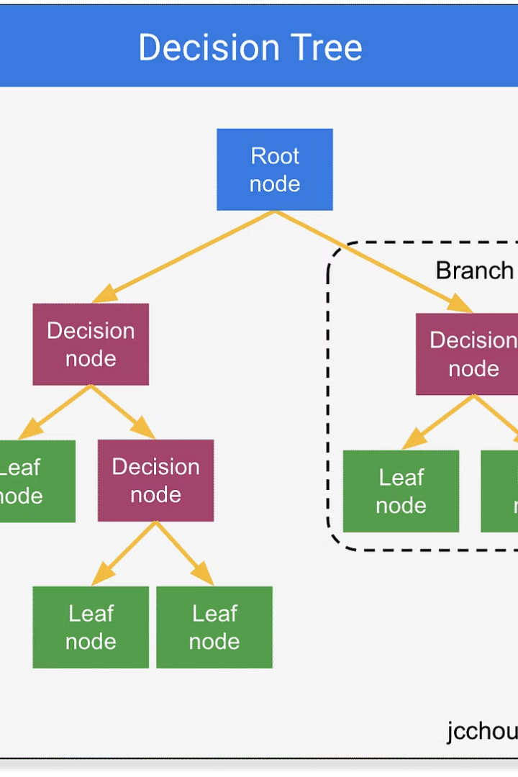
What is a Decision Tree?
Overall Tree Structure
Models decisions and possible outcomes.
Internal Nodes
Represent decision points using feature values.
Leaf Nodes
Show final outcomes or class labels.
Pathway
Follow splits to reach prediction based on inputs.

Slide 5
Categorical and Continuous Variable Decision trees
Categorical Variable decision tree
Continuous Variable Decision Tree
Returns binary result (“Spam” or “Not spam”)
Used when target variable is continuous
Result for new data points easily sorted into existing categories
Continuous features are split based on thresholds
More useful for predicting numeric values
(Weather prediction, Real estate prices, stock market predictors)
Decision is split into categories based on continuous characteristics of data
Notes:
wewjhjfrgjbrgjrgrgjrgb

Slide 6

Where Are Decision Trees Used?
Loan Approval Systems
Decision Trees predict loan eligibility by evaluating applicant features like credit score and income.
Medical Diagnosis
Assist clinicians in diagnosing diseases based on symptom and test result data.
Spam and Fraud Detection
Classify messages or transactions as legitimate or fraudulent using patterns in data.
Churn Prediction & Recommendations
Predict customer churn or recommend products such as vehicles based on historical data trends.

Slide 7
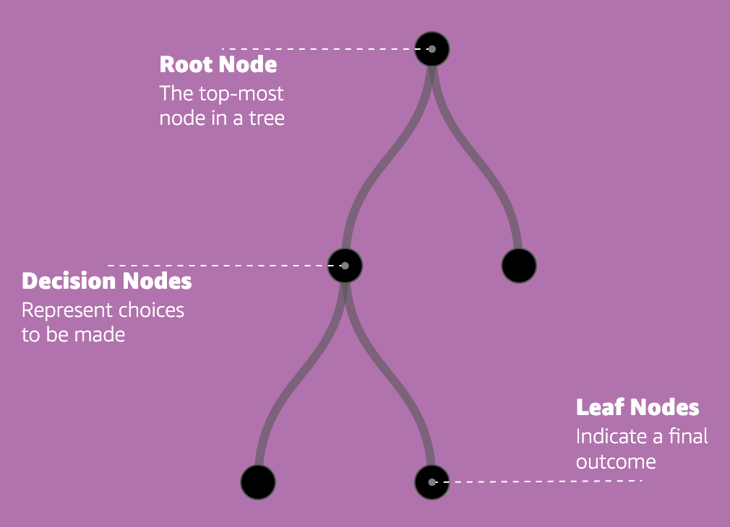
How Do Decision Trees Work?
Start at the root
The tree begins with the most informative feature
Split the data
Split data to purify classes or values.
Repeat the process
Continue until stopping criteria met.
Reach a prediction
Each path leads to a leaf node that gives the final output.
Common metrics used
Entropy and Gini index evaluate split quality.

Slide 8
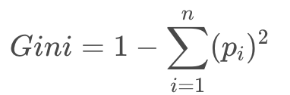
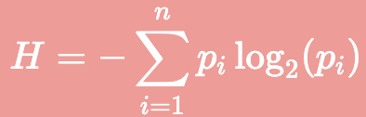
Entropy and Gini Index
Entropy
Gini Index
Measures disorder or impurity in data.
Another impurity measure.
Entropy = 0 → perfectly pure
Lower values indicate better splits.
Formula:
Formula:
Time Complexity for tree training:
O(m ×n log n)
n= number of lines
m= number of words
Notes:
Both are used to guide where a tree should split, the lower the value, the better the feature.

Slide 9
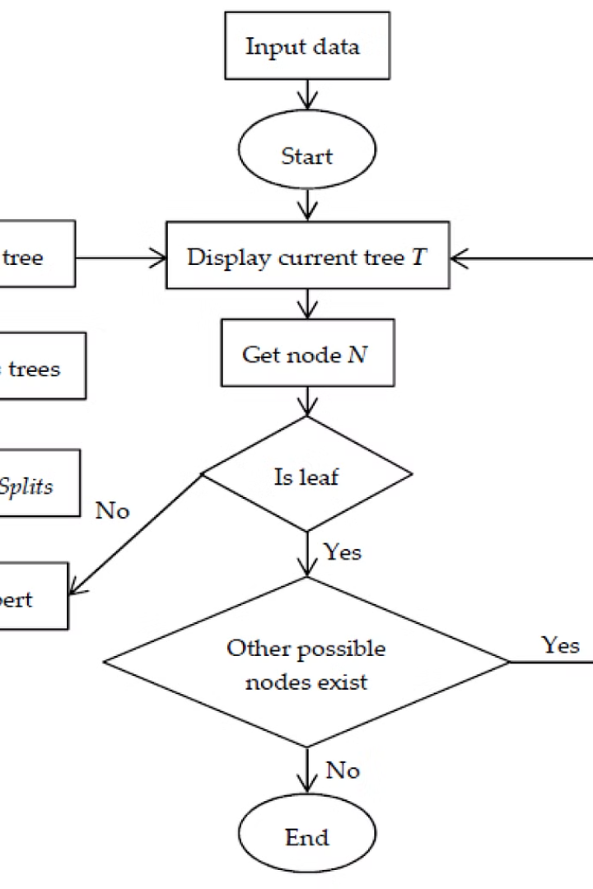



Types of Decision Tree Algorithms
ID3
Uses Information Gain as criterion, supports only categorical features.
C4.5
An extension of ID3 that supports continuous data and pruning to reduce overfitting.
CART
Constructs binary trees and uses the Gini Index for split quality measures.

Slide 10
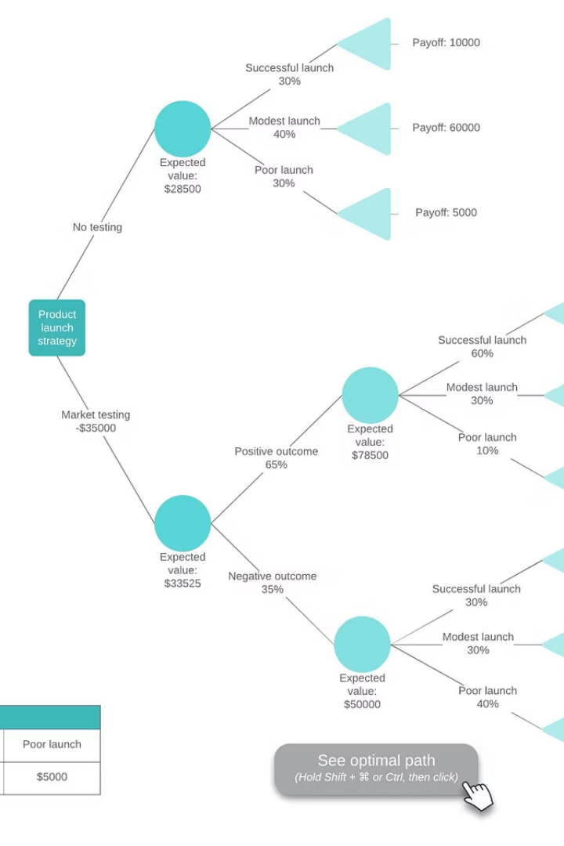



Types of Decision Tree Algorithms (Continued)
CHAID
MARS
Conditional Inference Trees
Chi-square based method for multi-way splits on categorical data.
Handles nonlinear relationships and interactions, mainly used for regression tasks.
Employs statistical tests for splits to reduce bias and overfitting issues.

Slide 11
Pros vs Cons of Decision Trees
Advantages
Disadvantages
Easy to interpret and visualize
Prone to overfitting with complex trees
Little data preprocessing needed
Small data changes alter tree structure
Handles numerical and categorical data
Bias toward attributes with many levels

Slide 12
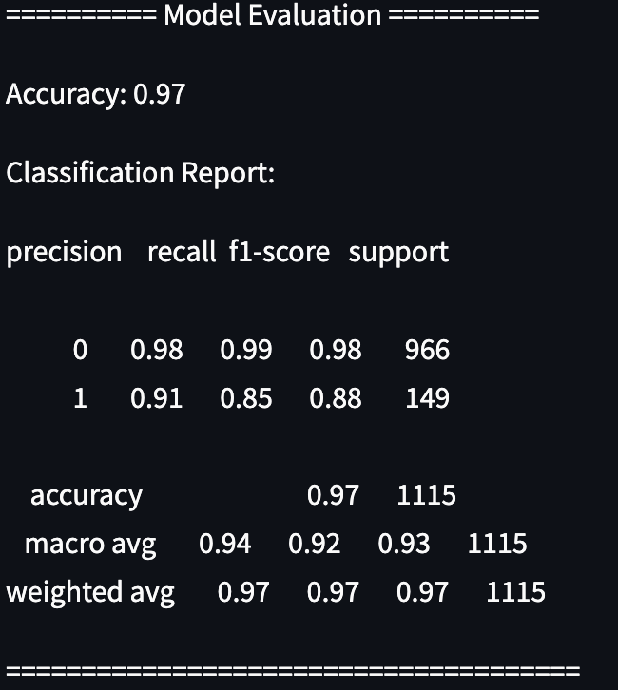
Implementation:
We trained our model using existing 5572 line dataset of emails or text messages labeled either spam or ham (not spam)
87% of the messages are ham
13% of the messages are spam
.fit() builds the decision tree using training data and optimizes the splits to find cluster for spam or ham messages
DecisionTreeClassifier()
Print the accuracy score of the model
Precision: predicts if message is spam or not spam
Recall: Percentage of messages correctly identified
Accuracy = (True positives - True negatives) / Total instances
Ask user for new message

Slide 13
References:
https://machinelearningmastery.com/a-tour-of-machine-learning-algorithms/
https://datasciencedojo.com/blog/gini-index-and-entropy/
https://www.geeksforgeeks.org/decision-tree/
https://www.geeksforgeeks.org/decision-tree-introduction-example/
https://mlu-explain.github.io/decision-tree/

Slide 14
Questions?

